Slide 1
Computer Graphics
Visible Surface Detection
Loknath Regmi

Slide 2
Visible Surface Detection
Two approaches
  Depends upon object definition or projected image
    Object-space
      Compares objects and parts of objects to each other within the scene
    Image-space
      Visibility is decided point by point at each pixel position on projected plane
@Loknath Regmi

Slide 3
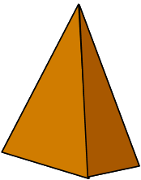

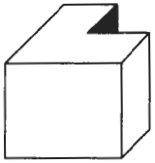
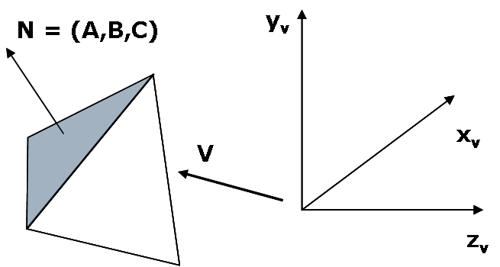
N
Back Face Detection Method
V
Fast and simple object-space method
Based on “inside” or “outside” test
Test whether view point is inside or outside the polygon surface
  Tested by the inequality: Ax + By + Cz + D = 0
    If view point is outside the surface → visible
    If inside → back face
  The test could be simplified by considering normal vector N = (A,B,C) to polygon surface and Vector V in viewing direction as:
    the polygon is back face if: V.N>0
If object description is converted to viewing co-ordinates then, V is along z_{v} axis i.e V = (0,0,V_{z}), then:
    V.N = V_{z}C
    i.e V.N > 0 → V_{z}C
So we need to consider only sign of C
For right handed viewing system with viewing direction along negative z_{v} axis, c<0 → back face
Convex polyhedron?→ no problem because either completely visible or completely hidden
Concave polyhedron?→ some problem; needs additional faces
More than one objects? in scene → problem
Eliminates about half of the polygon surface in a scene from further visibility tests
      What if C = 0 ??
      Grazing Viewing i.e viewing direction is perpendicular to surface normal→ also back face
      So, back face if C≤0
@Loknath Regmi

Slide 4
Depth Buffer (z-Buffer) method
Image-space method
Surface depth is compared at each pixel position on the projection plane
Usually applied to scene containing only polygon surfaces; but possible to apply for non-planar surfaces
For each pixel position (x,y) on projection plane, object depths can be compared by comparing z-values as each (x,y,z) position on a polygon surface corresponds to the orthographic projection point (x,y) on projection plane
Two buffers required
  Depth buffer: to store depth value for each position
  Refresh buffer: to store intensity values of each position
Drawback: Deals only with opaque surface but not with transparent surface
@Loknath Regmi

Slide 5
Depth Buffer (contd…)
Initialize the depth buffer and refresh buffer so that for all buffer positions (x,y),
  depth(x,y) = 0, refresh(x,y) = I_{backgrnd}
For each position on each polygon surface, compare depth values to previously stored values in the depth buffer to determine visibility
    Calculate the depth z for each (x,y) position on the polygon
    If z>depth(x,y), then set
      depth(x,y)=z, refresh(x,y)=I_{surf}(x,y)
s₃
s₂
s₁
y_{v}
(x,y)
x_{v}
      I_{backgrnd} = background intensity
      I_{surf}(x,y) = projected intensity value for the surface at pixel position (x,y)
z_{v}
@Loknath Regmi

Slide 6
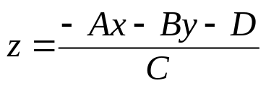
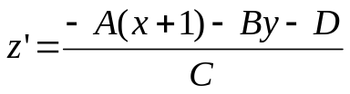
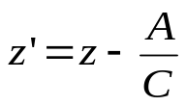
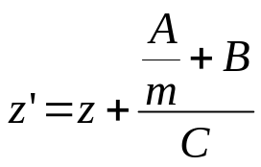
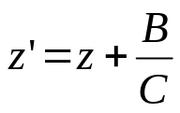
Depth Buffer (depth calculation)
From plane equation, depth is
For the next adjacent pixel in a scan line, depth is
Determine minimum and maximum y-coordinates for each polygon
Start from top scan line to bottom scan line
Starting from top vertex, calculate x position down the left edge of the polygon recursively as
x’ = x – 1/m
Thus depth value for the next pixel in left edge is obtained as
For vertical edge m = infinity, so:
y
y-1
or
x
x+1
top scan line’
left edge intersection
y scan line
m(x’-x)=y’-y=-1
bottom scan line
put x’ = x-1/m and y’ = y-1
y scan line’
y-1 scan line’
@Loknath Regmi
x
X’

Slide 7
A-Buffer Method
foreground
transparent
surface
background
opaque
surface
Extension of depth buffer method
Antialiased, area-average, accumulation-buffer
The depth buffer is expanded so that each position in the buffer can reference a linked list of surfaces thus enabling more than one surface intensity consideration
The object boundary could be antialiased
Each pixel position in the A-Buffer has two fields
  Depth Field → stores a positive or negative real number
    Positive→ single surface contributes to pixel intensity
    Negative → multiple surfaces contribute to pixel intensity
  Intensity Field → stores surface-intensity information or a pointer value
    Surface intensity if single surface → stores the RGB components of the surface color at that point and percent of pixel coverage
    Pointer value if multiple surfaces
  in case of surface linked list, the data for each surface in the linked list includes
    RGB intensity
    Opacity parameter
    Depth
    Percent of area coverage
    Surface identifier
    Other surface-rendering parameters
    Pointer to next surface
  Scanlines are processed to determine surface overlaps of pixels across the individual scanlines.
  Surfaces are subdivided into a polygon mesh and clipped against the pixel boundaries
  The opacity factors and percent of surface overlaps are used to determine the pixel intensity as an average of the contribution from the overlapping surfaces
d>0
I
depth
field
intensity
field
d<0
Surf1
Surf2
depth
field
intensity
field
@Loknath Regmi

Slide 8
Scan-Line Method
Extension of scanline algorithm for filling polygon interiors
Instead of filling just one surface, we deal with multiple surfaces
Construct edge tables and polygon tables
  Edge table contains → endpoints of each edge in the scene, inverse slope of each line and pointers to the polygon table to identify its corresponding surface
  Polygon table contains → plane equation coefficients, surface intensity, pointers to the edge table (optional)
Setup an active list (why active ??) of edges for those edges which cross the current scan line
  The edges are sorted in order of increasing x
Define flags for each surface to indicate whether a position is inside or outside the surface
  At leftmost boundary of surface flag == on and at rightmost boundary flag == off
@Loknath Regmi

Slide 9
Scan-Line Method (contd…)
B
E
For scan line 1
  The active edge list contains edges AB,BC,EH, FG
  Between edges AB and BC, only flags for s1 == on and between edges EH and FG, only flags for s2==on
    no depth calculation needed and corresponding surface intensities are entered in refresh buffer
For scan line 2
  The active edge list contains edges AD,EH,BC and FG
  Between edges AD and EH, only the flag for surface s1 == on
  Between edges EH and BC flags for both surfaces == on
    Depth calculation (using plane coefficients) is needed.
    In this example depth for s1 is less than for s2, so intensities for surface s1 are loaded into the refresh buffer until boundary BC is encountered
  Between edges BC and FG flag for s1 == off and flag for s2 == on
    Intensities for s2 are loaded on refresh buffer
For scan line 3
  Same coherent property as scan line 2 as noticed from active list, so no depth calculation needed between edges BC and EH
y_{v}
F
A
Scan Line 1
S1
S2
Scan Line 2
Scan Line 3
H
C
D
G
x_{v}
@Loknath Regmi

Slide 10
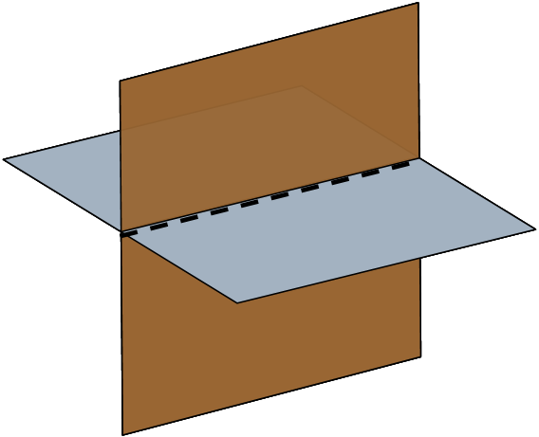
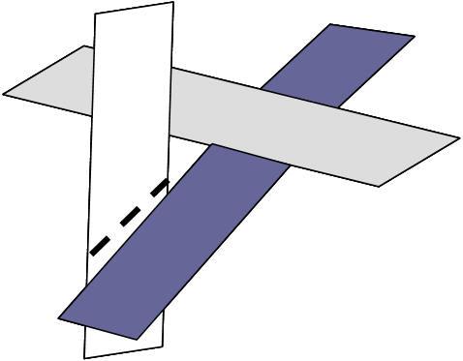
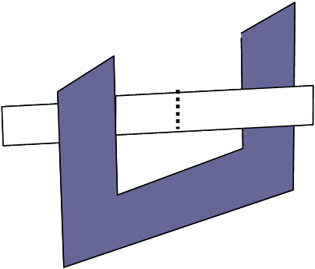
Scan-Line Method (contd…)
Problem: Dealing with cut through surfaces and cyclic overlap is problematic when used coherent properties
  Solution: Divide the surface to eliminate the overlap or cut through
Subdividing line
Subdividing line
y_{v}
E
B
F
Scan Line 1
A
Scan Line 2
Subdividing line
S1
S2
Scan Line 3
Scan Line 4
H
C
D
G
x_{v}
@Loknath Regmi

Slide 11
List Priority Algorithms
Determines a visibility ordering for objects ensures that a correct picture results if objects are rendered in that order.
e.g. if no object overlaps in ‘z’ then we need only to sort objects by increasing ‘z’ and render them in that order.
Farther objects are obscured by closer ones as pixels from the closer polygons overwrite those of more distant ones.
If objects overlap in ‘z’, we may still be able to determine a correct order.
If objects cyclically overlap, or penetrate each other, then there is no correct order.
@Loknath Regmi

Slide 12
List Priority Algorithms
Hybrids that combine both object and image precision operations.
Depth comparison and object splitting are done with object precision.
Scan conversion (which relies on ability of graphics device to overwrite pixels of previously drawn objects) is done with image precision.
@Loknath Regmi

Slide 13
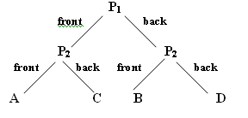
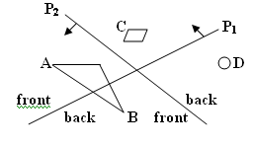
A. BSP TREE METHOD
Binary Space partitioning (BSP) tree is an efficient method for determining object visibility by painting surfaces onto the screen from back to front, as in painter’s algorithm
Useful when view reference point changes but the objects in a scene are at fixed position
Identifying surfaces that are “inside” and “outside” partitioning plane at each step of space sub division relative to viewing direction is required for visibility testing.
@Loknath Regmi

Slide 14
B.Depth-Sort Method
Simple and fast
Object spaced image space an method
Also called painters algorithms
Few object in scene➔ fast
the number of objects increases ➔ sorting process can become very complex and time consuming
Algorithms:
1. Sort all surfaces according to their distances from the view point.
2. Render the surfaces to the image buffer one at a time starting from the farthest surface.
3. Surfaces close to the view point will replace those which are far away.
4. After all surfaces have been processed; the image buffer stores the final image.
@Loknath Regmi

Slide 15
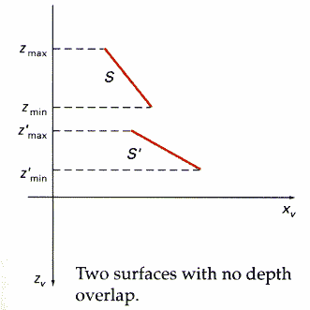
Depth-Sort Method
For example: : Assuming we are viewing along the z axis. Surface S with the greatest depth is then compared to other surfaces in the list to determine whether there are any overlaps in depth. If no depth overlaps occur, S can be scan converted. This process is repeated for the next surface in the list.
@Loknath Regmi

Slide 16
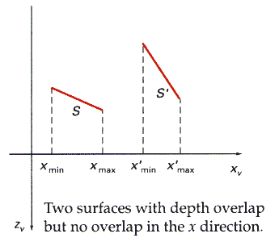
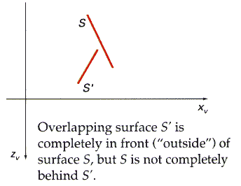
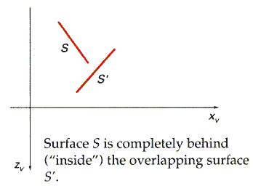
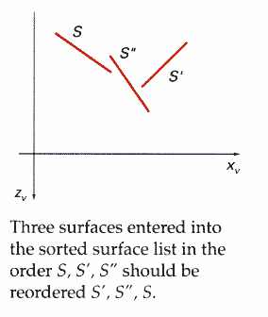
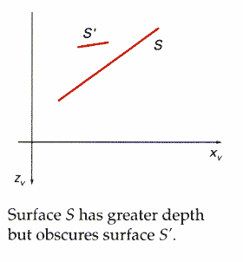
Depth-Sort Method
if depth overlap is detected, we need to make some additional comparisons to determine whether any of the surfaces should be reordered.
@Loknath Regmi

Slide 17
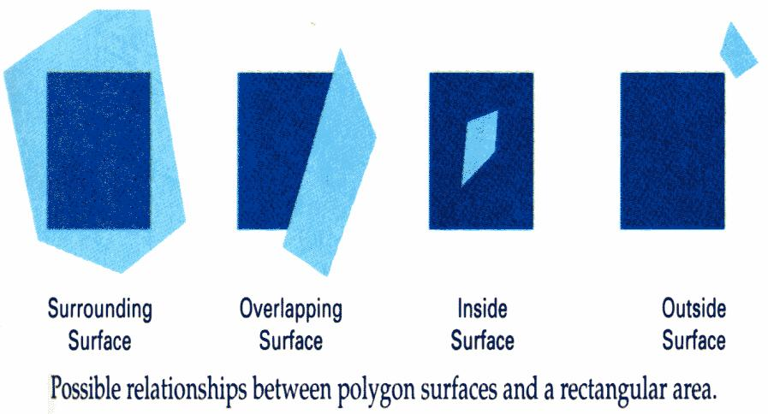
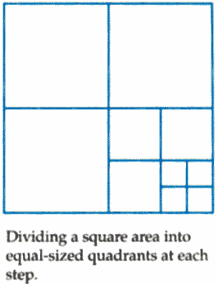
Area Subdivision Algorithms
Simple but less used method
Interesting concept but difficult to implement
total viewing area is successively divided into smaller and smaller rectangles until each small area is simple
i.e. it is a single pixel, or is covered wholly by a part of a single visible surface or no surface at all.
@Loknath Regmi

Slide 18
Area Subdivision Algorithms
First classify the surface as:
a single surface completely encloses the area Overlapping surface
a single surface that is partly inside and partly outside the area Inside surface
a single surface that is completely inside the area Outside surface
a single surface that is completely outside the area
2. Check the result from 1., that, if any of the following condition is true, then, no subdivision of this area is needed.
All surfaces are outside the area
surface is inside, overlapping or surrounding surface is in the area
A surrounding surface obscures all other surfaces within the area boundaries
For cases b and c, the color of the area can be determined from that single surface
@Loknath Regmi

